Slide 1
IAHR / ERCOFTAC Workshop on Refined Turbulence Modelling, Darmstadt, 2001
Test Case 9.2: Flow over a Series of Hills
Presentation of Geometry and Flow
Jochen Fröhlich
Institut für Hydromechanik,
Universität Karlsruhe
Germany
Joint work: C.P. Mellen, W.Rodi

Slide 2
I
Motivation
Geometry

Slide 3

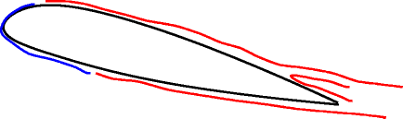
EU-Project LESFOIL: LES of flow around the A - airfoil
turbulent boundary layer
transition
turbulent separation
recirculation
Desire for test case
- just this feature
- cheaper than airfoil (LES)

Slide 4
Test case requirements
Massive, turbulent separation
Separation not fixed by geometry (smooth surface)
2d geometry
Realistic Reynolds number
Cheap to compute
Reference data available

Slide 5
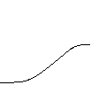
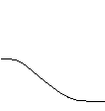
2D Hill Flow: [Almeida et al.93] 4th ERCOFTAC/IAHR ’95
Single hill: Inflow condition required
yields long domain (unsteady signal for LES)
Series of hills: Periodicity not fully achieved in experiments
Exp. data can not be used
…
…
#7

Slide 6
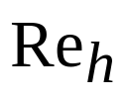
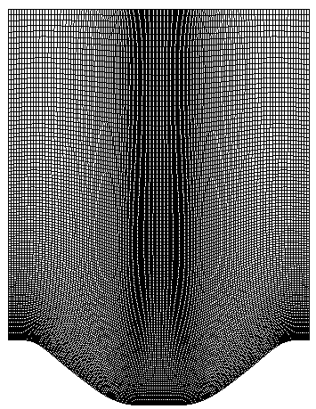
2D Hill Flow: [Almeida et al.93]
Both:
  Almost square channel => secondary flow !?
  Sidewalls expensive to include
  Channel quite high => expensive
= 60000
Consecutive hills are close
Back view
hill

Slide 7
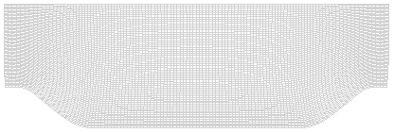
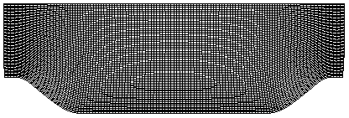
New Test Case Geometry [MFR00]
Conserve shape of hill => experience, easily accessible
Streamwise periodicity => no doubt about inflow conditions
Larger distance between hills => Reattachment point is sensitive
=> more Relaxation before next separ.
=> Lx/Ly ~ 3 as in plane channel
Spanwise homogeneity => periodic conditions in LES
        => truly 2D for RANS
No experimental data => use fine-grid LES as reference
lower Re => fine-grid LES is feasible, Re-indep.
Re with bulk velocity => easier to impose & to compare

Slide 8
II
Flow

Slide 9
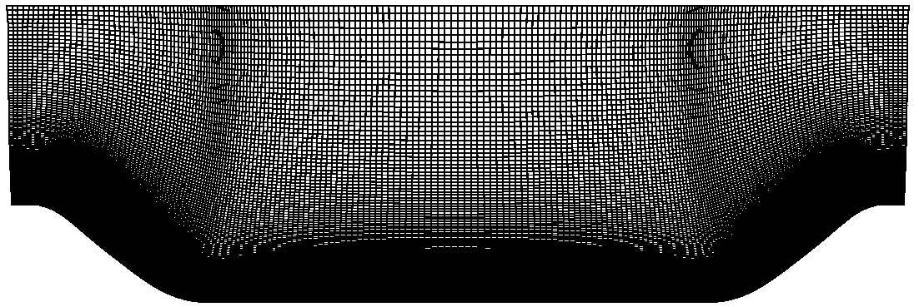
Highly – resolved LES [MFR00]
Grid Ni x Nj x Nk = 196 x 128 x 186 (inner cells) by elliptic eq.
Lz =4.5h
Re_h = 10595
Bottom: no-slip
top: wall function
SGS: Dynamic Smagorinsky
Averaging in span & time (T=55 Lx/Ub)
96 Proc. on IBM-SP, 60000 h
Similar computation by [Temmerman, Leschziner 01]

Slide 10
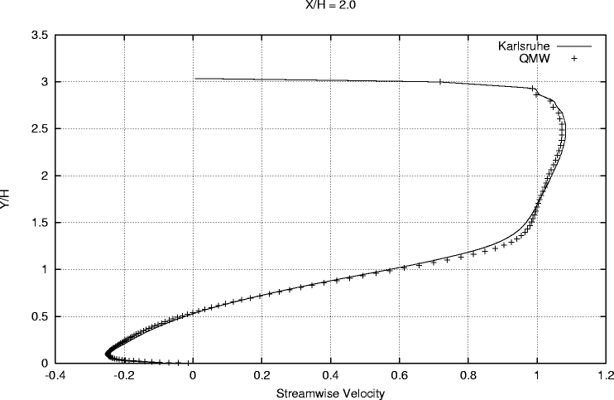
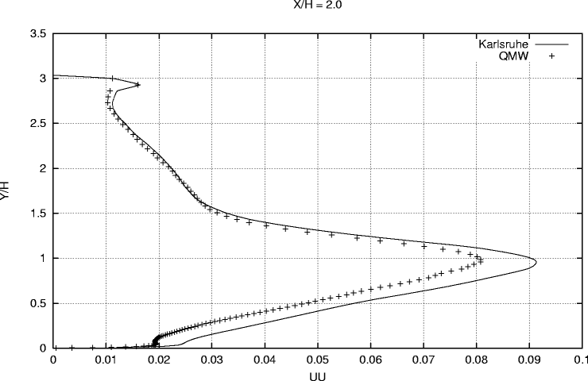
Reference simulations
        < u > < uu >
x/h = 2

Slide 11
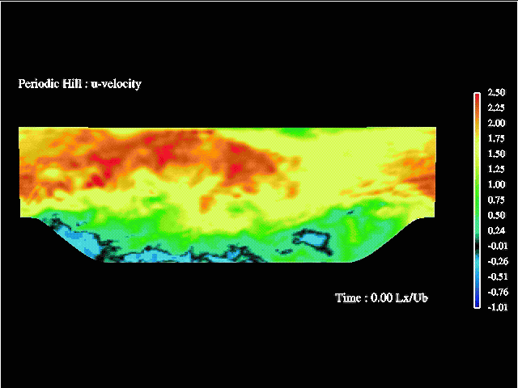
Steamwise velocity

Slide 12
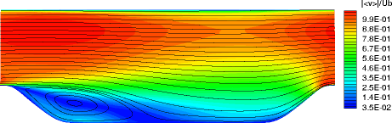
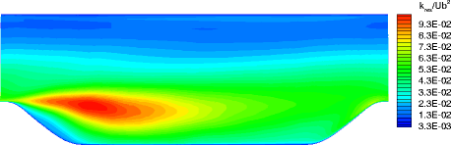
Average flow
| < v > | and Streamlines
Resolved kinetic energy

Slide 13
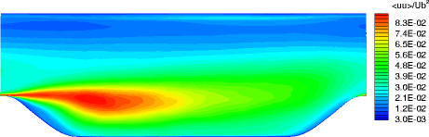
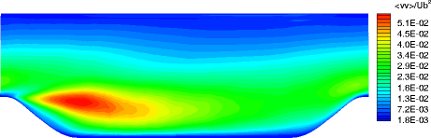
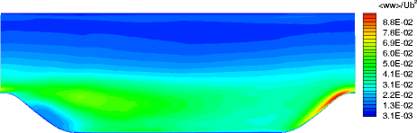
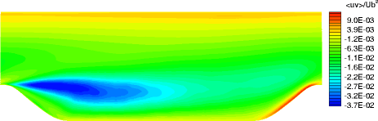
Reynolds stresses
< uu > < vv >
< ww > < uv >

Slide 14
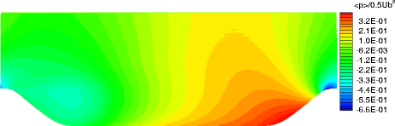
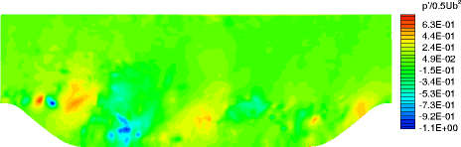
Pressure
< p >
p - < p >

Slide 15
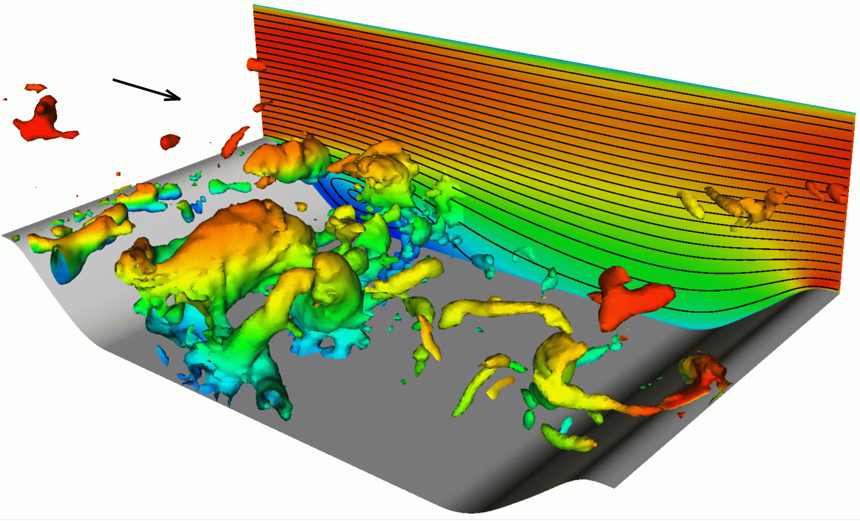
Flow structure
K.–H. vortices
Görtler vortices
Helical pairing

Slide 16
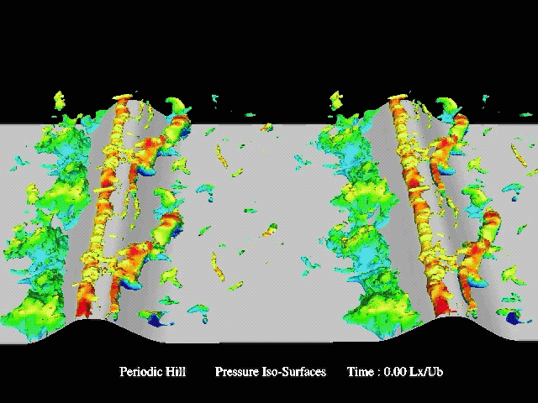
Pressure surface

Slide 17
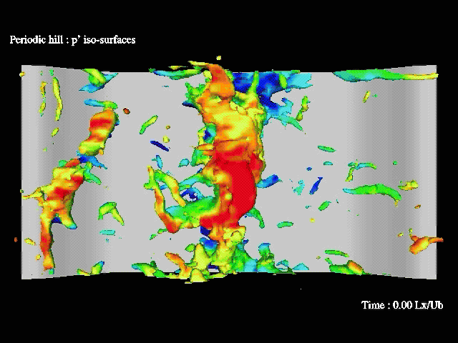
Pressure fluctuation

Slide 18
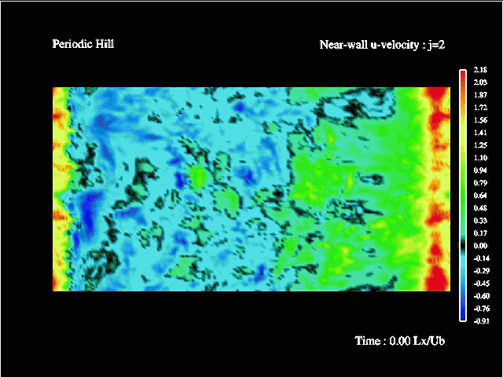
Near – wall u-velocity

Slide 19
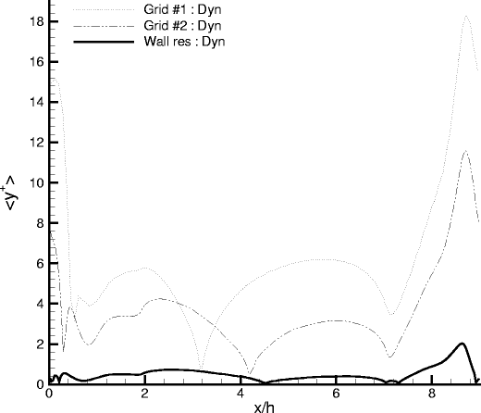
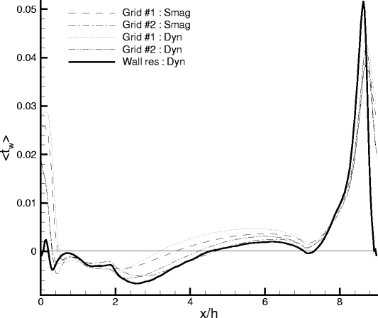
Experiences
good streamwise discretization near crest of hill required
Hill is flat near crest
τ
< y+ >
< >
w

